Slide 1







Slide 2
Homeowner Rehabilitation & Disaster Recovery Programs
Presented by Jackie Cobbins

Slide 3
HOME Program Background
Under the HOME Investment Partnerships Program, the Department of Housing and Urban Development allocates funds to eligible State and local governments to strengthen public-private partnerships. Also, to expand the supply of decent, safe, sanitary, and affordable housing for low-income and very low-income families. Funds may be used to carry out multi-year housing through acquisition, rehabilitation, and new construction of housing, as well as tenant-based rental assistance.

Slide 4
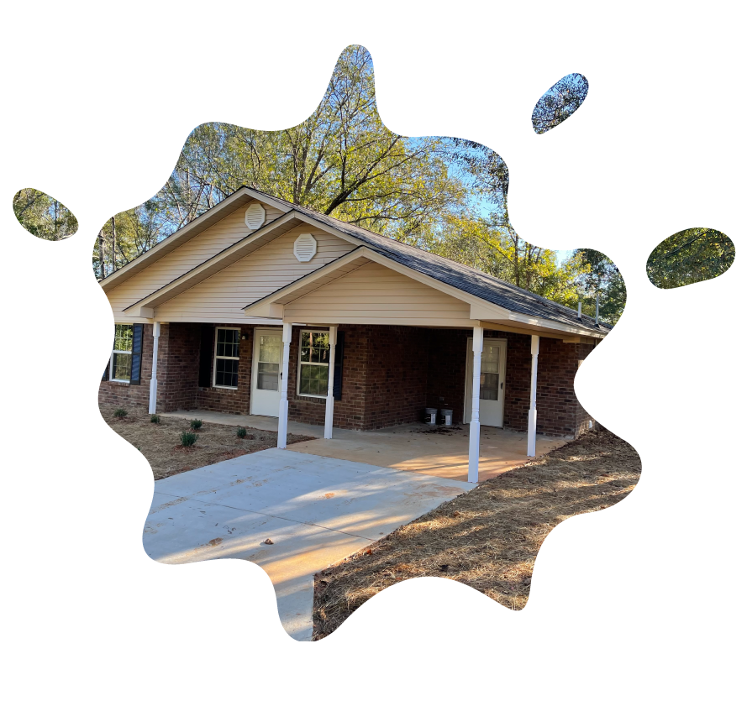
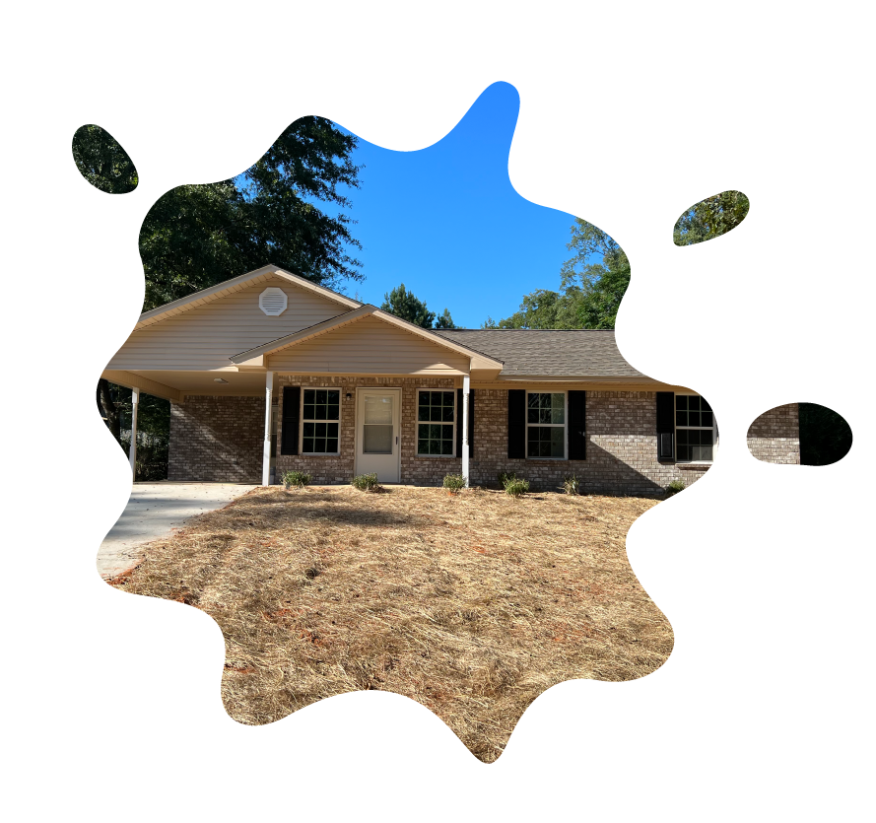
Homeowner Rehabilitation

Slide 5
HOME Program Background
The Homeowner Rehabilitation Program allows the use of funds to assist existing low-income homeowners with rehabilitation, replacement of manufactured homes, and reconstruction of owner-occupied units. Homeowners must occupy the property as their principal residence.
Funds are distributed STATEWIDE in accordance with the State’s Consolidated Plan and the One-Year Action Plan.

Slide 6
2026 Homeowner Rehabilitation Funding Availability
PROGRAM CATEGORIES | ALLOCATION
Homeowner Rehabilitation | $6,600,000
Maximum Award up to $600,000
ELIGIBLE ACTIVITIES
Rehabilitation | Reconstruction/Replacement
Projects MUST consist of 100% Rehabilitation OR Rehabilitation and Reconstruction 100% Reconstruction is NOT allowed

Slide 7
Homeowner Rehabilitation
APPLICATIONS
Accepted Annually
ELIGIBLE APPLICANTS
Local Units of Government
Nonprofit Organizations
Planning and Development Districts
FUNDS DISTRIBUTION
Competitive Process

Slide 8
Homeowner Rehabilitation
Application Phases
APPLICATIONS ACCEPTED IN TWO PHASES
PHASE I
APPLICANT
PHASE II
HOMEOWNER

Slide 9



Homeowner Rehabilitation
AWARDS
Forgivable Grant
AWARD NOTIFICATION
Reservation Letter
PROCESS
15-Month Benchmark

Slide 10
Homeowner Rehabilitation
Eligible Activities
Rehabilitation: Repair major deficiencies affecting safety and habitability.
Reconstruction/Replacement: Replacement of existing housing unit.

Slide 11
Homeowner Rehabilitation
Requirements
Must occupy the unit as principal residence
Legal ownership of property
Proof of owner occupancy – Prior 12 months

Slide 12
Homeowner Rehabilitation
Requirements
Property must be a single-family, owner-occupied unit.
Property taxes must be current or in an exempt status.

Slide 13
NEW & NOTABLE

Slide 14


Online Application Submission

Slide 15
Homeowner Rehabilitation
Online Application
Applications accepted via Online Portal - Neighborly Software.
Link - Homeowner Rehabilitation Website
Request for Cash Submission
Easy Tracking
Training to Come
Technical Assistance Available
Application Portal
Open Date
Close Date

Slide 16
Homeowner Rehabilitation
New & Notable
HOMEOWNER WAITLIST
TWO-YEAR FUNDING CYCLE

Slide 17


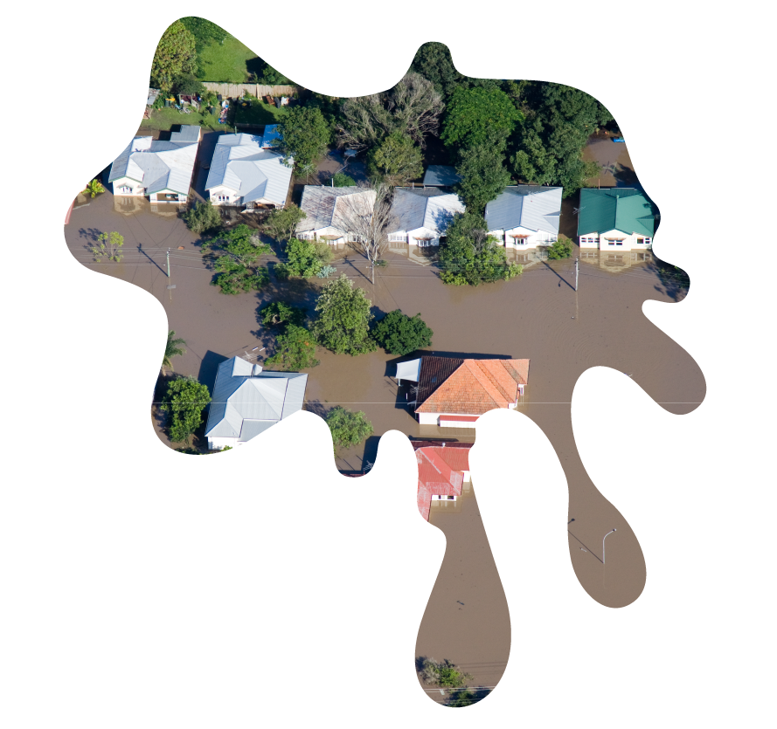
Disaster Recovery Program

Slide 18
Disaster Recovery Program
The HOME Disaster Recovery (DR) program provides housing assistance to counties in a declared area to low-income households impacted by a disaster to help rebuild a community’s housing stock and encourage the resettlement of displaced homeowners.

Slide 19
Disaster Recovery Program
Degrees of Damage
AFFECTED: A home is considered affected if the damage is mostly cosmetic.
MINOR: A home with repairable non-structural damage.
MAJOR: A home with structural damage or other significant damage that requires extensive repairs.
DESTROYED: The home is a total loss.

Slide 20
Disaster Recovery Program
Eligible Applicant
    Counties Identified in a FEMA Declaration
Eligible Activities
    Rehabilitation
    Repair
    Replacement

Slide 21
Disaster Recovery Program
INELIGIBLE USE OF FUNDS
DR funds cannot be used to assist in the immediate clean-up or restoration of services in the aftermath of a disaster. Funds are a potential source of financing for long-term housing recovery efforts.
Direct homeownership assistance to purchase a new stick-built home.
Tenant-Based Rental Assistance (TBRA) Rental housing units.
Hotels or other temporary shelter that does not constitute housing.

Slide 22
Disaster Recovery Program
Requirements
  Must have occupied the unit as principal residence
  Legal ownership of property
  Proof of owner occupancy – Prior 12 months
  Property must be a single-family, owner-occupied unit

Slide 23
Disaster Recovery Program
APPLICATIONS
Applications for DR are now open and are accepted until funds are fully allocated.
ELIGIBLE APPLICANTS
Counties ONLY
FUNDS DISTRIBUTION
FEMA Declaration Disaster
MINIMUM AWARD REQUEST
$200,000

Slide 24
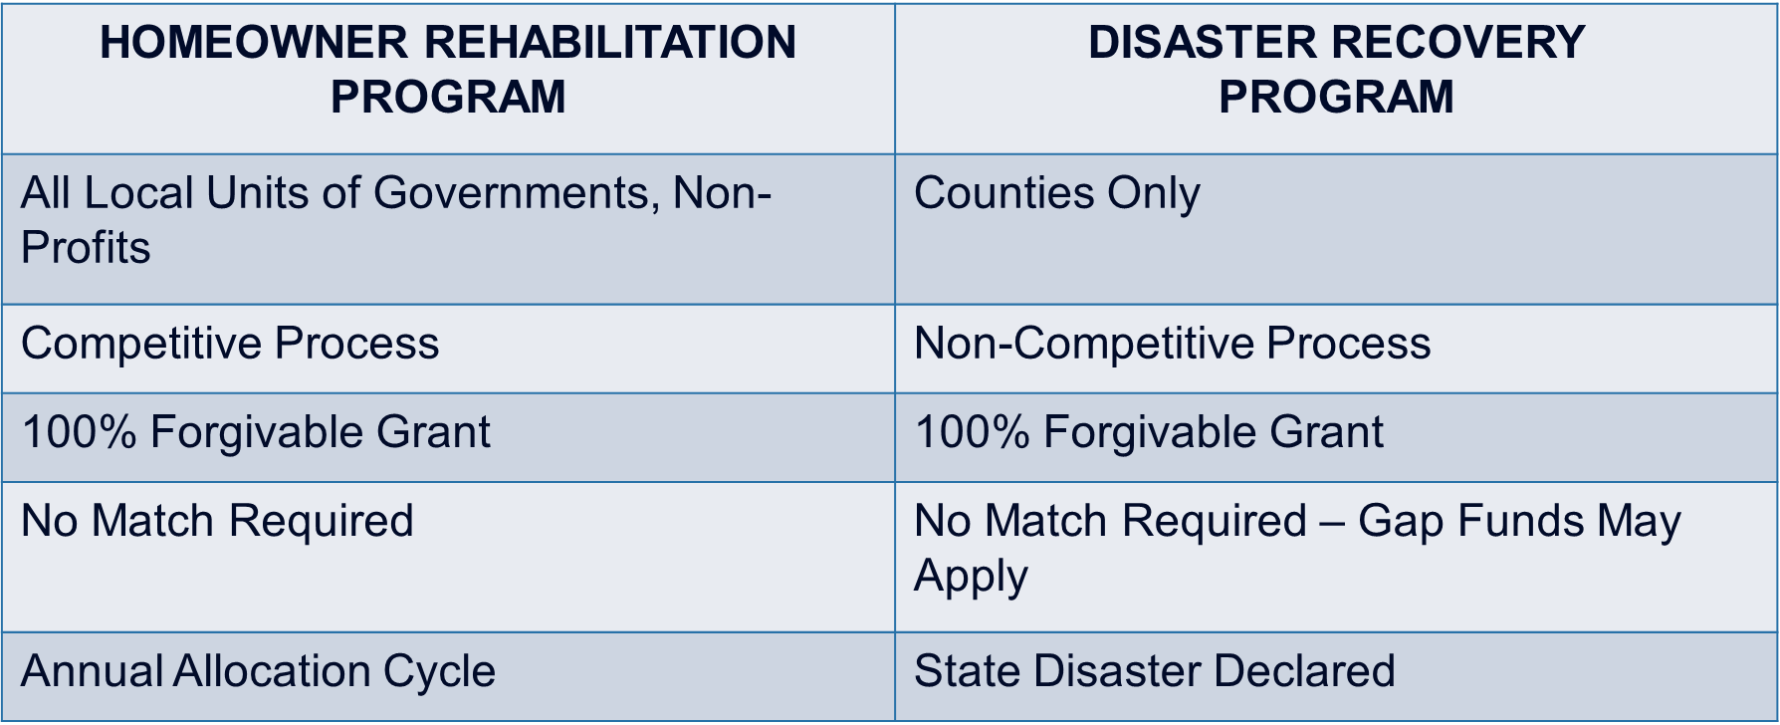
OVERVIEW
Homeowner Rehabilitation vs. Disaster Recovery

Slide 25
QUESTIONS

Slide 26

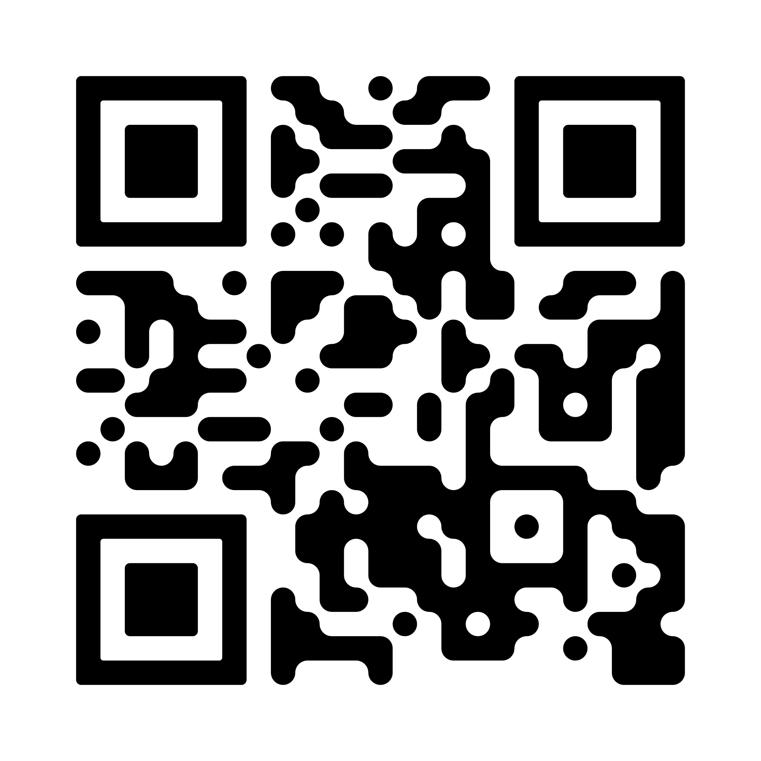
HOMEOWNER REHABILITATION PROGRAM
Jackie Cobbins
Program Manager
jackie.cobbins@mshc.com
601.718.4635

